Slide 1
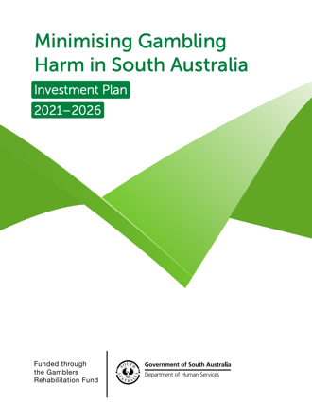
Monitoring & Evaluation Framework
Minimising Gambling Harm in South Australia – Investment Plan 2021-2026

Slide 2
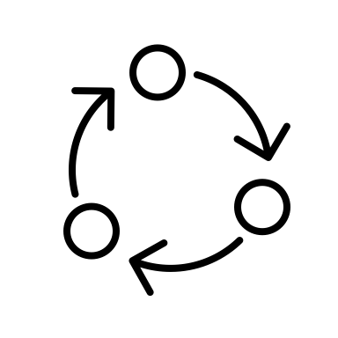
Overview
Strategic priorities of the Minimising Gambling Harm Investment Plan 2021-2026
Approach to Monitoring & Evaluation
South Australians recognise gambling harm and know how to help
Key Performance Indicators and Measures
Key Result Areas
People get the right support at the right time
Key Result Areas (KRAs)
Key Performance Indicators (KPIs)
Key Performance Measures (KPMs)
Preventing and intervening early in gambling harm
Progress will be monitored annually with performance targets set
An agile system equipped to identify, prevent and respond to emerging harm and need
2

Slide 3
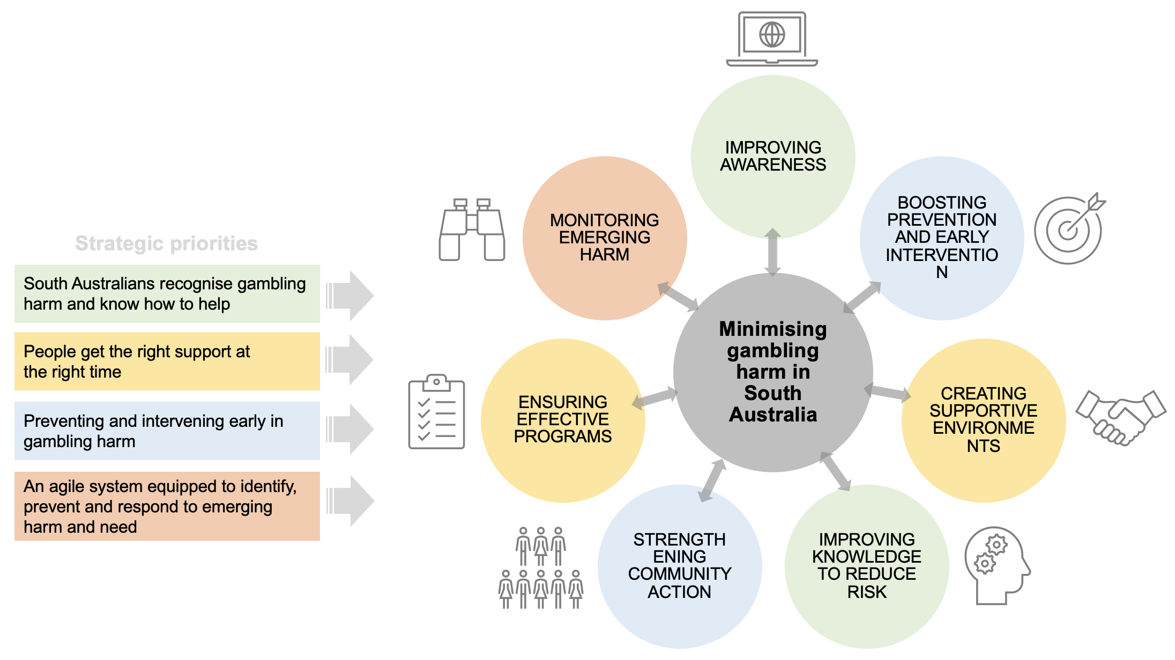
Our approach to design of M&E Framework
Public health approach and effective individual interventions are BOTH needed to mitigate harm
Improving awareness – There must be awareness of gambling harm and services and programs to mitigate harm.
Improving knowledge to reduce risk – Individuals, communities and stakeholders must all have knowledge about how to reduce gambling harm and the risk of gambling harm.
Boosting prevention and early intervention – For the Gambling Help service system to be effective, its core activities must incorporate a strong focus on prevention and early intervention of gambling harm. Similarly, industry must also participate in efforts to identify, recognise and minimise gambling harm.
Creating supportive environments – Environments and settings in the community must be identified to encourage stakeholders to work proactively to identify and mitigate gambling harm (e.g., community services must screen for harm, councils must develop effective public health responses to prevent and mitigate harm, regulators must be able to access and use research to ensure that regulation and policy can support harm-minimisation).
Strengthening community action – The community must be sufficiently aware of risks and have sufficient knowledge to enable them to consider the implications of gambling harm and to take appropriate action in their lives, work and leisure activities.
Ensuring effective programs – All programs designed and delivered must follow a strong evidence base and be continually evaluated in terms of their effectiveness in mitigating gambling harm. This will lead to continuous improvement of programs and strategies throughout the Investment Plan period - 2021-2026.
Monitoring emerging harm – Harm is continually evolving and it is critically important to monitor the harm associated with current and emerging gambling products and environments, and to also monitor levels of harm in the population.
3

Slide 4
South Australians recognise gambling harm and know how to help
Strategic Priority 1

Slide 5
What does scientific literature tell us?
Literature shows that certain product characteristics can pose harm
Event frequency
Continuity
Stake options (multiple + variable bets riskier)
Accessibility
Cash access options
Size of prizes
Speed/cost of play
Product characteristics, individual differences + environments each contribute to harm
Knowledge theorised to be a protective factor, but evidence still emerging
A range of risk segments including young people may be protected from harm if they receive information and education about gambling harm
Literature shows that EGMs and wagering in particular are strongly associated with harm
Some behaviours may protect from harm (e.g., balancing gambling with other activities)
Prevalence of adolescent gambling is likely declining, but parent gambling also a likely risk (some associations in research)
At present, significant stigma associated with PG – Implies community not supporting those harmed – Some evidence that stigma can be reduced
5

Slide 6
Strategic Priority: South Australians recognise gambling harm and know how to help
Key Result Area 1 - South Australians understand the harm of gambling and protect themselves and others from harm
Key Performance Indicators (KPIs)
Key Performance Measures (KPMs)
Methods
KPI1. South Australians understand and recognise early signs of gambling harm.
South Australians understand the continuum of gambling harm and can recognise early signs of gambling harm across all life domains
KPI2. South Australians understand why gambling products can be harmful and know how to help and protect themselves and others from harm.
South Australians have knowledge of harmful features of gambling products including those relevant to EGMs, sports betting and wagering & table games.
Survey
South Australian’s understand and use evidence-based strategies to protect themselves and others from gambling harm
KPI3. South Australians are aware of communications campaigns targeting gambling harm and communications campaigns are effective.
Prompted awareness, behaviour change and reach of communication campaigns
Media metrics
Key Result Area 2 - South Australians talk to young people and children about the harms of gambling
KPI 1. South Australians talk with young people or children about the harms of gambling.
Proportion of South Australians who talk with young people or children about the harms of gambling
Survey
Key Result Area 3 - There is an increasing level of understanding in the South Australian public for people harmed by gambling.
KPI 1. South Australians show understanding for people harmed by gambling and know how to help.
Level of perceived stigma towards South Australians impacted by gambling harm
Level of motivation of South Australians to personally provide help and support to people harmed by gambling
Survey

Slide 7
Preventing and intervening early in gambling harm
Strategic Priority 2

Slide 8
What does scientific literature tell us?
Public health approaches have potential to support harm-minimisation – this is about taking a more collaborative, holistic approach to harm-minimisation – Currently, potential to improve focus on prevention and early intervention
Potential for wide spread screening to identify harm so broader community has greater ownership of harm
Boredom and social isolation a risk factor for reliance on gambling as a leisure activity
Tertiary prevention
Secondary prevention
Primary prevention
Developing personal skills
Creating supportive environments
Strengthening community action
Re-orienting health services
Building healthy public policy
Ottawa charter for health promotion
8

Slide 9
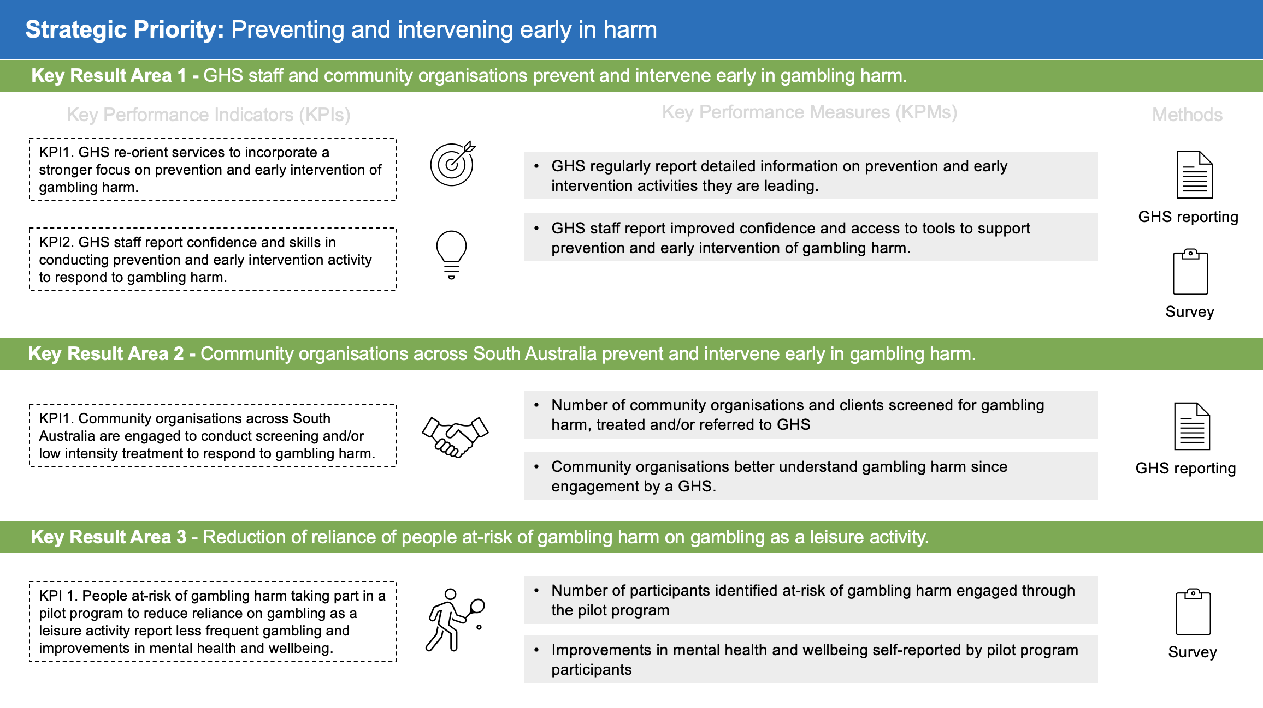

Slide 10
People get the right support at the right time
Strategic Priority 3

Slide 11
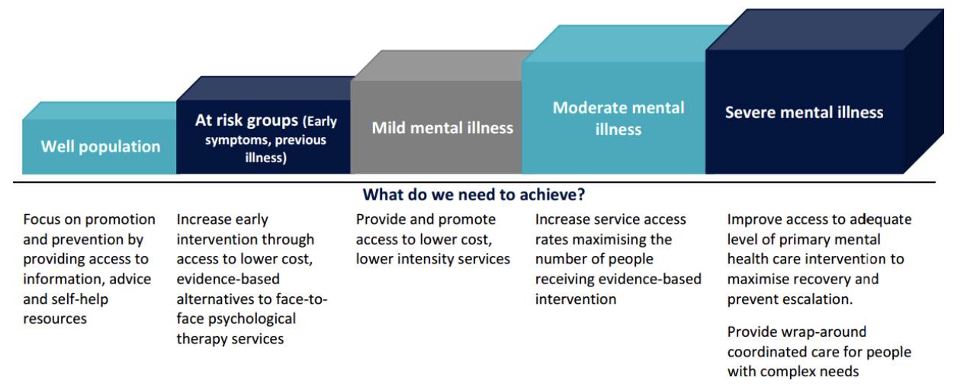
What does scientific literature tell us?
Awareness of GHL + GHO low - ~29% of adults aware of GHL and 1.2% aware of GHO (Woods et al, 2018)
Not many referrals from industry and community sources > Implies potential to monitor referrals
Important to monitor the effectiveness of treatment programs and ensure that evidence-based treatment methods are being used – e.g., CBT and third wave therapies
Research highlights strong demand for ‘self-help’ (e.g., Hing et al, 2011)
Potential for improved client screening for mental health disorders and cross-referrals
Relapse is common in problem gambling, but the extent of relapse is unknown
11

Slide 12
Strategic Priority: People get the right support at the right time
Key Result Area 1 - Number of clients identified by the Gambling Helpline, Gambling Help Online, Industry and the Community.
Key Performance Indicators (KPIs)
Key Performance Measures (KPMs)
Methods
KPI1. Number of clients received from different sources including the: (a) Gambling Helpline (b) Gambling Help Online (c) Industry and (d) the community.
Number of client referrals by source
Client Data Set
Key Result Area 2 - Gambling Help Services achieve therapeutic goals, reduce gambling harm and retain clients in treatment.
KPI1. GHS clients show improvements in gambling behaviour.
Gambling behaviours improve within GHS clients to reduce gambling harm
KPI 2. GHS clients ‘fully’ or ‘substantially’ reach their therapeutic goals at the conclusion of treatment.
Proportion of GHS clients reaching their therapeutic goals at treatment conclusion
Client Data Set
KPI 3. GHS clients fully complete their treatment.
Proportion of GHS clients fully completing their treatment at GHS
KPI 4. GHS clients maintain recovery after treatment.
Proportion of GHS clients maintaining their recovery
Key Result Area 3 - Access to help and awareness of available services and resources to minimise gambling harm.
KPI 1. South Australians are aware of the Gambling Helpline, Gambling Help Online and services and resources.
Awareness of the Gambling Help Line, Gambling Help Online, South Australian GHS including CALD and Indigenous services.
Awareness of South Australian resources developed to minimise gambling harm
KPI 2. South Australians are aware that help resources to address gambling harm are available online
Survey
KPI 3. South Australians harmed by gambling are getting the help they need – whatever the source (e.g., family, friends, GHS, another service)
South Australians harmed by gambling received the help they needed to reduce gambling harm and help was provided before a crisis

Slide 13
An agile system equipped to identify, prevent and respond to emerging harm and need
Strategic Priority 4

Slide 14
What does scientific literature tell us?
Many benefits of collaboration (e.g., Macao - university and gaming provider partnership)
Knowledge Translation (KT) is about bridging gap between research + practice ‘Getting the right information, to the right people, at the right time, and in a format they can use, so as to influence decision making’
KT is about: (Mackay et al, 2015)
Consensus around best practices in reducing risk and treating problem gamblers
Application of information from related fields (e.g. addiction)
Collaboration or co-design with end users (e.g. at risk gamblers)
And the development of tools and initiatives to promote responsible gambling
Regulators can benefit from information on gambling research (e.g., EGM note acceptors, cashless gaming trials, Prohibited Features Register in NSW etc.)
Highlights the potential for industry-OPG-regulator-GHS collaboration
Also potential for improved translation of research to South Australian GHS (including clinical practice)
14

Slide 15
Strategic Priority: An agile system equipped to identify, prevent and respond to emerging harm and need
Key Result Area 1 - Quality and outcomes of work undertaken by OPG with key stakeholders to foster a collaborative and agile approach to harm-
minimisation in South Australia.
Key Performance Indicators (KPIs)
Key Performance Measures (KPMs)
Methods
KPI1. Quality and outcomes of work of OPG to partner with the (A) regulator, (B) help services and (C) industry to prevent and reduce gambling harm.
The quality of relationship with stakeholders
Business metrics
The effectiveness of work and collaboration with stakeholders
Key Result Area 2 - Commissioning, funding and dissemination of applied research to inform gambling harm-minimisation.
KPI1. Quality of knowledge translation and dissemination of GRF funded research findings to inform the practices of key stakeholders in gambling harm-minimisation.
All fact sheets from research reports are published on the OPG website and describe practical applications of findings for a South Australian context
KPI 2. Commissioning of and completion of research projects against priority topics to improve gambling harm-minimisation in South Australia and inform GRF-funded activities and state-wide policy.
Investment in research aligns to strategic priorities of the investment plan and research can be used to further improve the South Australian gambling harm-minimisation service system.
Survey

Slide 16
Summary
Measurement is the first step to understanding what’s happening in a service system
This can support strategies to improve service system effectiveness
The Monitoring & Evaluation Framework provides a basis for monitoring and understanding what’s happening in the gambling harm-minimisation service system.
GHS will be key in making this happen!
Participating in surveys and interviews
Contributing to activities that will support success – i.e., working with OPG to improve referral pathways, undertaking early intervention/prevention activities
Supporting data collection
Reporting on early intervention/ prevention activities at the GHS etc.

